Slide 1
Azure PaaS Fundamentals (SQL Database)
Jes Borland
PFE, SQL Server

Slide 2
Cloud-first
Our strategy for feature development is cloud-first.
Query Store, Adaptive Query Processing, and Automated Tuning were released to and tested in SQL Database first.
Most new features will follow this pattern!
Roadmap: https://azure.microsoft.com/en-us/roadmap/?category=databases

Slide 3
Pricing and Licensing
DTU
Vcore
Notes:
What is it?
How many will I need?

Slide 4
DTUs
Database Throughput Unit - "a blended measure of CPU, memory, I/O (data and transaction log I/O)".
Doubling DTUs by increasing tiers will double the resources available.
Guaranteed performance.
When workload exceeds one of those resources, throughput is throttled.
Migrating workloads
DTU Calculator - http://dtucalculator.azurewebsites.net/
New workloads
Start low, work up
Notes:
https://docs.microsoft.com/en-us/azure/sql-database/sql-database-what-is-a-dtu
https://docs.microsoft.com/en-us/azure/sql-database/sql-database-benchmark-overview

Slide 5
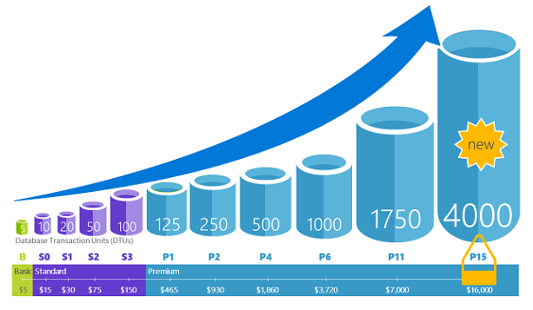
Notes:
Scaling up through tiers
Basic - B
Standard –S1 – S12 – 10-3,000
Premium – P1 – P15 – 125-4,000

Slide 6
Vcore (Preview)
Scale CPU/memory separately from storage
Gen 4 - Intel E5-2673 v3 (Haswell) 2.4 GHz processors
Gen 5 - Intel E5-2673 v4 (Broadwell) 2.3 GHz processors
General Purpose |  | Business Critical
Gen 4 | Gen 5 | Gen 4 | Gen 5
1-24 cores | 2-80 cores | 1-24 cores | 2-80 cores
7-164 GB memory | 11-440 GB memory | 7-168 GB memory | 11-440 GB memory
5GB – 4TB Premium blob storage |  | 5GB – 4TB local SSD storage

Slide 7
SQL Database feature parity with SQL Server
Unavailable features
Agent - jobs, alerts
BACKUP, RESTORE, ATTACH, DETACH
Change Data Capture
CLR
Database mail
Database mirroring
Data Quality Services, Master Data Services
Database snapshots
Filestream
Policy-based Management, Resource Governor
Service Broker
Profiler
Unavailable T-SQL
Cross-database queries
Global temp tables
Server-level roles, system tables, system views, DMVs
USE
Some features only available in specific tiers
In-Memory OLTP
Columnstore indexes
SSAS, SSIS, and SSRS
Notes:
https://docs.microsoft.com/en-us/azure/sql-database/sql-database-features
https://docs.microsoft.com/en-us/azure/sql-database/sql-database-transact-sql-information

Slide 8
Single databases and Elastic Pools
Single databases
Compute is dedicated to one database
Elastic Pools
A group of databases that share a "pool" of compute
Designed for a group of databases with varying, unpredictable workloads
"If the sum of the DTUs of performance levels for single databases is more than 1.5x the eDTUs needed for the pool, then an elastic pool is more cost effective“
Notes:
https://docs.microsoft.com/en-us/azure/sql-database/sql-database-elastic-pool
https://docs.microsoft.com/en-us/azure/sql-database/sql-database-elastic-jobs-overview

Slide 9
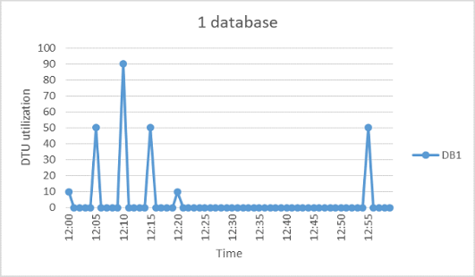
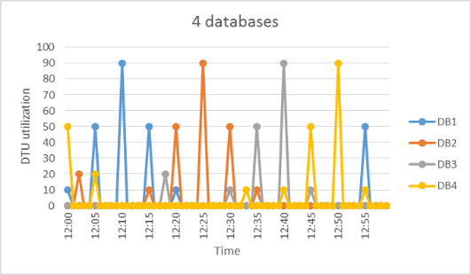
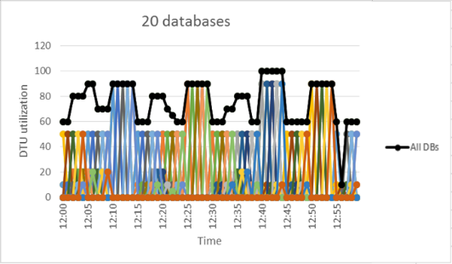

Slide 10
Elastic Pools Tools
Elastic Jobs
Run T-SQL jobs against one or more databases in the pool
https://docs.microsoft.com/en-us/azure/sql-database/sql-database-job-automation-overview
Elastic Query
Execute T-SQL queries against one or more databases in the pool
https://docs.microsoft.com/en-us/azure/sql-database/sql-database-elastic-query-overview
Elastic Transactions
Execute cross-database transactions using ADO.NET
https://docs.microsoft.com/en-us/azure/sql-database/sql-database-elastic-query-overview

Slide 11
Setup
Planning
Single or elastic pool
Initial DTU/vCore tier
SQL server to assign to
A logical grouping of SQL databases
Does not provide server-level settings like a SQL Server instance
Does not provide cross-database querying
Security - what IP addresses/ranges will have access?
Set at the SQL server level

Slide 12
Demos - Single database
Portal
New-AzSqlDatabase.ps1
Notes:
Create Azure SQL Database.ps1

Slide 13
Demos - Elastic Pools
Portal
New-AzSqlElasticPool.ps1
Notes:
Make note that this is very, very basic. Elastic pools are typically a lot more work to administer and use.

Slide 14
Administration

Slide 15
Backups
Performed automatically - part of the managed services through PaaS
Full backup weekly
Differential every few hours
Transaction log every 5-10 minutes
Uses read-access geo-redundant storage
Retention
Up to 200% of your maximum provisioned database storage at no cost
Basic - 7 days
Standard, Premium - 35 days
Long-term backup retention (preview) - up to 10 years
Notes:
https://docs.microsoft.com/en-us/azure/sql-database/sql-database-automated-backups

Slide 16
Restores
Can restore to a point-in-time using Portal or PowerShell
How long will it take? Depends on:
Database tier
Size of backup
Number of logs and transactions to be replayed
Amount of activity in the region

Slide 17
Demo – Restore
Portal
PowerShell

Slide 18
CHECKDB
No need to run - leave to Microsoft
Data Integrity in Azure SQL Database - https://azure.microsoft.com/en-us/blog/data-integrity-in-azure-sql-database/

Slide 19
Index maintenance
You can still run ALTER INDEX REBUILD and ALTER INDEX REORGANIZE
Do you need to?
Without SQL Server Agent, need to find an alternative method
Point an IaaS instance to the SQL Database and use SQL Server Agent
Azure Automation - PowerShell + T-SQL

Slide 20
Replacing SQL Server Agent with Azure Automation
Automation is another PaaS offering
Create one or more accounts; each account can have one or more runbooks
Runbooks can be
Graphical
PowerShell
PowerShell Workflow
PowerShell scripts can be written to run T-SQL
Use the Runbooks Gallery to find pre-configured Runbooks
Update-SQLIndexRunbook
Enter parameters
Schedule
Notes:
https://docs.microsoft.com/en-us/azure/automation/automation-offering-get-started
https://docs.microsoft.com/en-us/azure/sql-database/sql-database-manage-automation
https://docs.microsoft.com/en-us/azure/automation/automation-powershell-workflow
https://geeks.ms/davidjrh/2015/10/08/rebuilding-sql-database-indexes-using-azure-automation/
https://sqlperformance.com/2017/06/azure/automation-methods

Slide 21
Demo
Portal
Notes:
Search term is: Indexes tables in an Azure database if they have a high fragmentation
Update-SQLIndexRunbook

Slide 22
How scaling works
Changing the service tier and/or performance level of a database creates a replica of the original database at the new performance level, and then switches connections over to the replica.
No data is lost during this process but during the brief moment when we switch over to the replica, connections to the database are disabled, so some transactions in flight may be rolled back.
The length of time for the switch over varies, but is generally under 4 seconds is less than 30 seconds 99% of the time.
If there are large numbers of transactions in flight at the moment connections are disabled, the length of time for the switch over may be longer.
Notes:
https://docs.microsoft.com/en-us/azure/sql-database/sql-database-service-tiers#scaling-up-or-scaling-down-a-single-database

Slide 23
Scaling limitations
Scaling up
If you upgrade to a higher tier or level, maximum database size doesn’t change unless you specify it
If upgrading a database with geo-replication enabled, the recommendation is to upgrade the secondaries first
Scaling down
The database size must not be larger than the maximum database size for the lower tier or level
When you downgrade to a lower tier, your disaster recovery options (such as backup retention period) may change

Slide 24
Demo
Portal
Set-AzSqlDatabase.ps1

Slide 25
HA/DR

Slide 26
HA
Fully managed.
At least three copies of your data exist in the same region.
Can be combined with Availability Zones.
Availability Zones are separate physical data center locations in the same Azure region.
The database can and will be moved for patching and maintenance.
Application needs built-in resiliency and retry logic.
Notes:
https://docs.microsoft.com/en-us/azure/architecture/resiliency/

Slide 27
DR
Backups
Active geo-replication
Up to four readable secondary databases in different region(s)
Each database is a separate charge, so be careful of tiers. Primary and secondary can be different.
Failover: manual
On failover, update application connection string to new server name
Failover groups
One or more databases in a group
Can have a read-write listener or read-only listener
Failover: automatic or manual
On failover, if application is directed to listener name, no need to update connection string
If automatic is chosen, you can set a "grace period", which determines how long the system waits before initiating failover. This potentially reduces data loss.
Notes:
https://channel9.msdn.com/Shows/Data-Exposed/Azure-SQL-Database-Geographic-Failover-at-Scale
https://docs.microsoft.com/en-us/azure/sql-database/sql-database-geo-replication-overview

Slide 28
After setup
Practice planned, manual failover
https://docs.microsoft.com/en-us/azure/sql-database/sql-database-geo-replication-portal#initiate-a-failover
Ensure application connects and latency is acceptable
Failover back to primary data center

Slide 29
Demo
Set up geo-replication
Portal

Slide 30
Security

Slide 31
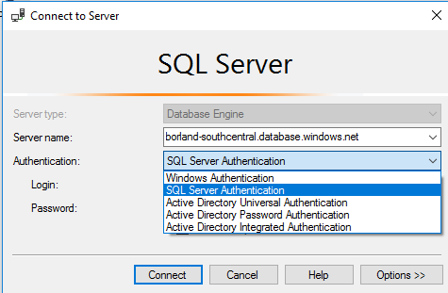
Access
SQL Authentication
Standard username/password authentication.
When you first create a SQL server, you create an admin login.
Use this credential to connect to any database on the server as dbo.
Use this credential to create logins at the server level or users in databases.
Azure Active Directory Authentication
Requires Azure Active Directory.
You can create one AD admin login per SQL server (in addition to the SQL admin login).
Connect via integrated Windows authentication, using an Azure AD username and password, or application token authentication.
Notes:
https://docs.microsoft.com/en-us/azure/active-directory/active-directory-whatis

Slide 32
Roles
Server-level admin roles
dbmanager - create new databases
loginmanager - create new logins in master database
Server-level non-admin users can be created
Database users can be tied to a server-level login, or contained.
Database-level roles
db_accessadmin, db_backupoperator, db_datareader, db_datawriter, db_ddladmin, db_denydatareader, db_denydatawriter, db_owner, db_securityadmin
Can also GRANT and REVOKE permissions on objects

Slide 33
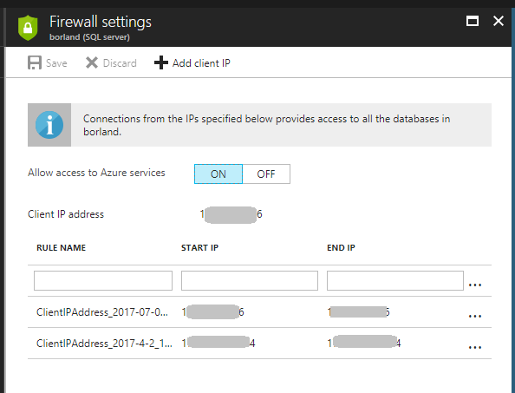
Firewall
Each SQL server has a firewall, which controls access to the databases created on it.
Create firewall rules to allow access.
IP address or range.
Azure services.
SQL Databases can have database-level rules set.
Only configurable with T-SQL.

Slide 34
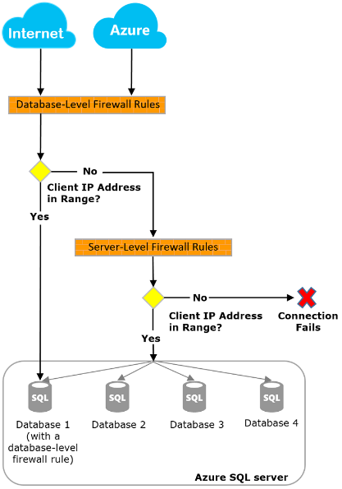

Slide 35
Data
Column encryption is supported
Transparent Data Encryption
On by default for databases created after May 2017
Uses built-in server certificate, rotated every 90 days
That certificate protects the database encryption key
Enable using Portal, T-SQL, or PowerShell
Always Encrypted
Fully supported in SQL Database
Notes:
https://docs.microsoft.com/en-us/sql/relational-databases/security/encryption/transparent-data-encryption-with-azure-sql-database
https://docs.microsoft.com/en-us/sql/relational-databases/security/encryption/always-encrypted-database-engine#configuring-always-encrypted

Slide 36
Auditing
Events are written to an Azure storage account for review
Levels
Server-level
Server-level policies are applied to all databases on the server
Database-level
If using both
Make sure they use different storage accounts
Audit different event types
View logs
Portal
T-SQL - sys.fn_get_audit_file
SSMS - Merge Audit Files
Power BI
Notes:
Lessons learned…

Slide 37
Threat Detection
Based on machine learning algorithms
Requires Auditing be enabled
Checks for
SQL injection
SQL injection vulnerability
Anomalous client login
If events are triggered, an email is sent
Additional cost per month

Slide 38
Data Migration Tools

Slide 39
Data Migration Assistant (DMA)
Downloadable tool
Scenarios
SQL Server database to SQL Database - finds blockers, unsupported features
SQL Server database to on-premises or Azure VM SQL Server database - schema, data, users, server roles, logins
SQL Server database upgrade - breaking changes, behavior changes, deprecated features, new features to benefit from
Notes:
https://www.microsoft.com/en-us/download/details.aspx?id=53595

Slide 40
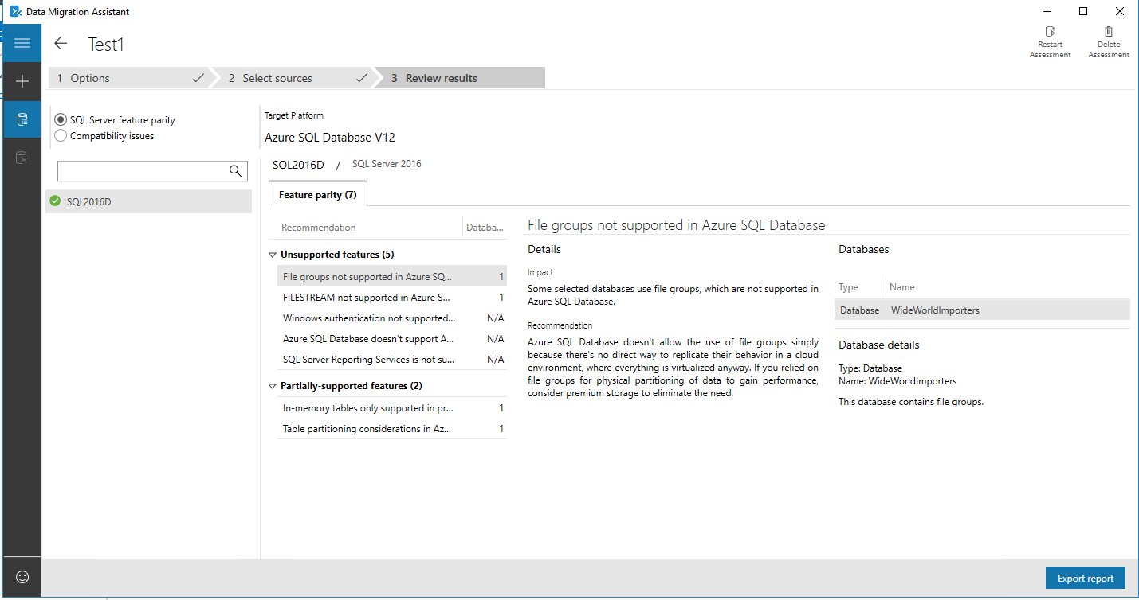

Slide 41
Demo
DMA
Notes:
Demo - my SQL2016D Azure VM has this installed

Slide 42
BACPAC
Create a BACPAC to migrate from SQL Server to SQL Database
T-SQL files for schema
bcp files for data

Slide 43
Transactional replication
SQL Server 2012+
Run DMA first to resolve any incompatibilities
Ensure your SQL Database tier is high enough to support the initial writes for synchronization
Set up your distributor and publisher locally, make SQL Database the subscriber
When ready to migrate, stop application updates, ensure all transactions are replicated, then point application to SQL Database

Slide 44
Performance Tuning Tools

Slide 45
"A bad query is always worth tuning"
Using SQL Database, you are paying for every bit of CPU, memory, read, and write
Tune your queries to be as efficient as possible

Slide 46
Query Performance Insight
A real-time view of how queries are affecting your database
Requires Query Store be enabled (it’s enabled by default)
View top resource-consuming queries
CPU, data IO, log IO, duration, execution count
View long-running queries
Get Performance Recommendations for a query
Notes:
https://docs.microsoft.com/en-us/azure/sql-database/sql-database-query-performance

Slide 47
Performance Recommendations
Create index
High, Medium, Low
If index is implemented and doesn't offer a benefit, will be reverted
Drop index
Duplicate indexes - same key and index columns, filters, and partition schema
Unused for a long period of time (93 days)
Parameterize queries
Will be recommended if queries are constantly recompiled but have the same execution plan
Enables forced parameterization on the database
Fix schema issues
Procedure or function '' expects parameter '', which was not supplied.
Invalid column name '*'.
Invalid object name '*'.
Column name or number of supplied values does not match table definition.
Could not find stored procedure '*'.
Procedure or function * has too many arguments specified.
Notes:
https://docs.microsoft.com/en-us/azure/sql-database/sql-database-advisor

Slide 48
Automatic Tuning
Executed queries are monitored for improvements; improvements are applied and measured
Automatic index management
Creates useful indexes
Drops duplicate or unused indexes
If improvement isn't significant, actions are reverted
Automatic plan choice correction
If plan regression is detected, the database will switch to the last known good plan for that query
Notes:
https://docs.microsoft.com/en-us/azure/sql-database/sql-database-automatic-tuning

Slide 49
Monitoring Tools

Slide 50
Dynamic Management Views
Querying DMVs requires VIEW DATABASE STATE.
A subset of DMVs is available for querying in SQL Database.
Other DMVs have been created to address SQL Database specifically.
Wait statistics - sys.dm_db_wait_stats
Resources statistics - sys.dm_db_resource_stats
Geo-replication - sys.geo_replication_links

Slide 51
Demo
Azure SQL DB DMVs.sql

Slide 52
Extended Events
Using XE requires Control permission to create sessions.
A subset of events is available for use in SQL Database.
T-SQL differences
[CREATE | ALTER | DROP] EVENT SESSION <name> ON DATABASE
DMVs referencing XE are sys.dm_xe_database_...
Targets
Ring buffer - in memory, not persisted
Event counter - in memory, not persisted
Event File - write to an Azure Storage container, persisted
SSMS 17.x gives you the familiar GUI.

Slide 53
Demo
Azure SQL DB XE.sql

Slide 54
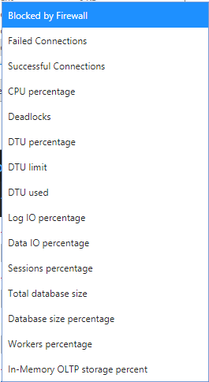
Alert rules (Classic)
Monitor your databases - when set conditions are met, an email will be sent
Can tie into a webhook so that when the alert is raised, an Automation Runbook fires
Portal
Choose a metric
Set a condition - less than, equal to, greater than
Set a threshold
Pick a period of time
PowerShell
http://www.mikefal.net/2016/08/23/creating-alerts-for-azure-sql-database-with-powershell/
Will be deprecated in June 2019

Slide 55
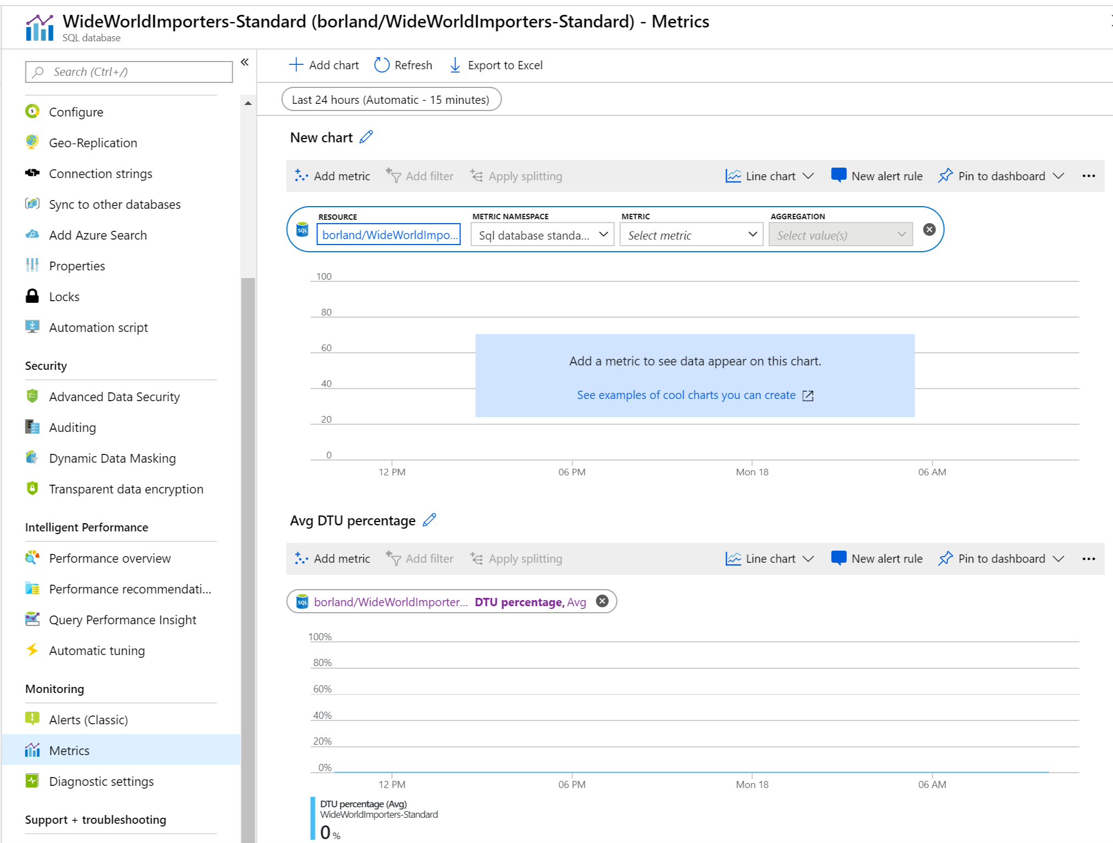
Metrics
Add charts to the Portal to view resource consumption

Slide 56
Alert rule
Click “New Alert Rule”.
Metrics
Not functional at this time.
Activity Log
Set alerts for activities such as Delete SQL Database, Pause SQL Data Warehouse, and more.
Email or text a person or group if the alert is triggered.

Slide 57
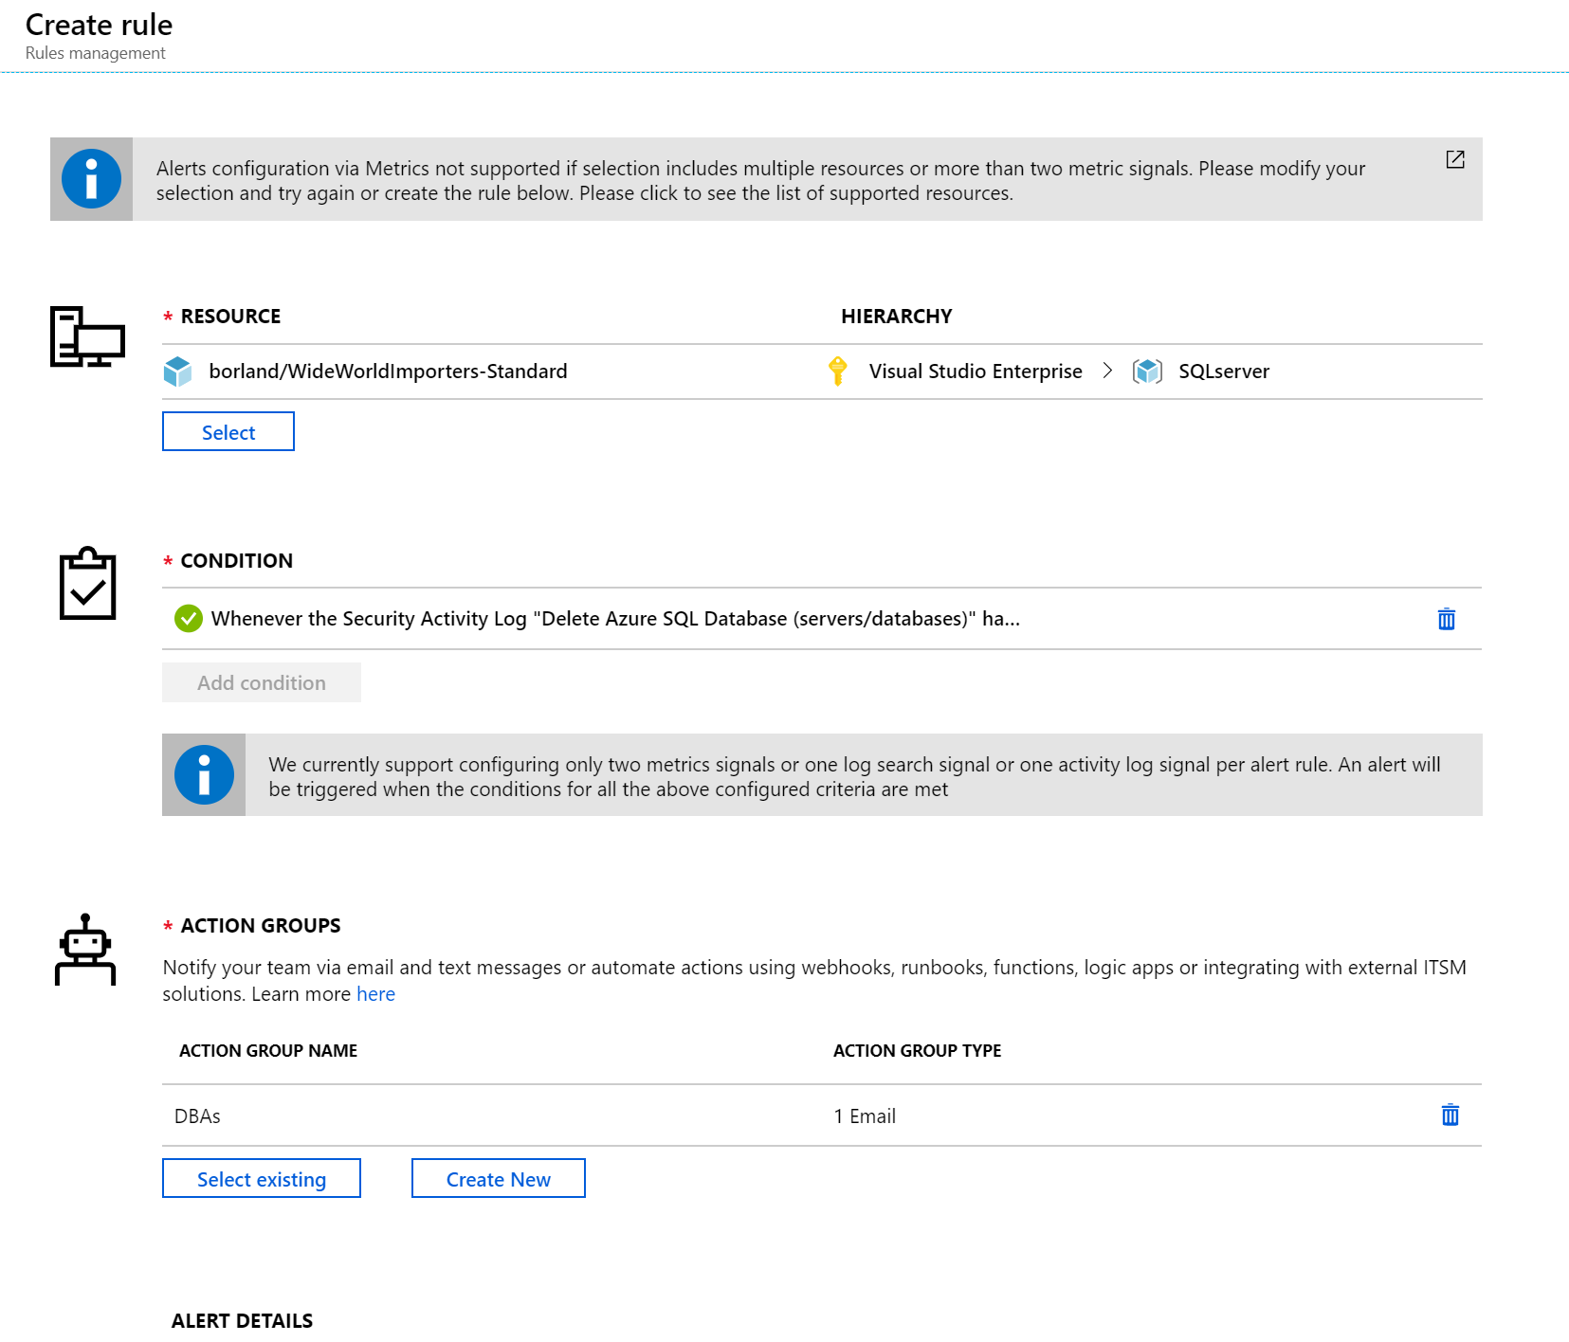

Slide 58
Azure SQL Analytics
Cloud-based monitoring solution.
Uses Azure Diagnostic metrics + Log Analytics.
Monitor Azure SQL Database using Azure SQL Analytics (Preview) https://docs.microsoft.com/en-us/azure/azure-monitor/insights/azure-sql?toc=%2Fazure%2Fsql-database%2Ftoc.json

Slide 59
Software suites
System Center Management Pack for Microsoft Azure SQL Database - https://www.microsoft.com/en-us/download/details.aspx?id=38829
SentryOne SQL Sentry
Solarwinds Database Performance Analyzer
Red Gate SQL Monitor

Slide 60
Developers: what you need to know

Slide 61
Your application will be disconnected from your database
Patching occurs in the background
Hardware can fail
Services and regions can have outages
Building resilient applications - https://docs.microsoft.com/en-us/azure/architecture/resiliency/
Determine RPO and RTO
Determine service SLAs and your application SLAs
Design for resiliency
Retry transient failures
Load balance
Replicate data
Degrade gracefully
Test for resiliency
Test for load

Slide 62
Working with geo-replication
Designing highly available services using Azure SQL Database - https://docs.microsoft.com/en-us/azure/sql-database/sql-database-designing-cloud-solutions-for-disaster-recovery
Active - Passive
Best for read-write workloads, with low latency
Active - Active
Best for read-heavy workloads, with read latency being most important

